Slide 1
Digital Content Coordinator
With the CRTcollective

Slide 2


06/2022 – 12/2022
After completing Dr. Tony Dunbar’s LIS course “Critical Race Information Theory”, he approached me with a part-time job opportunity
Job description: Assist CRTcollective with creating, managing, and scheduling social media content and reach out/schedule guest contributors for podcast and blog

Slide 3
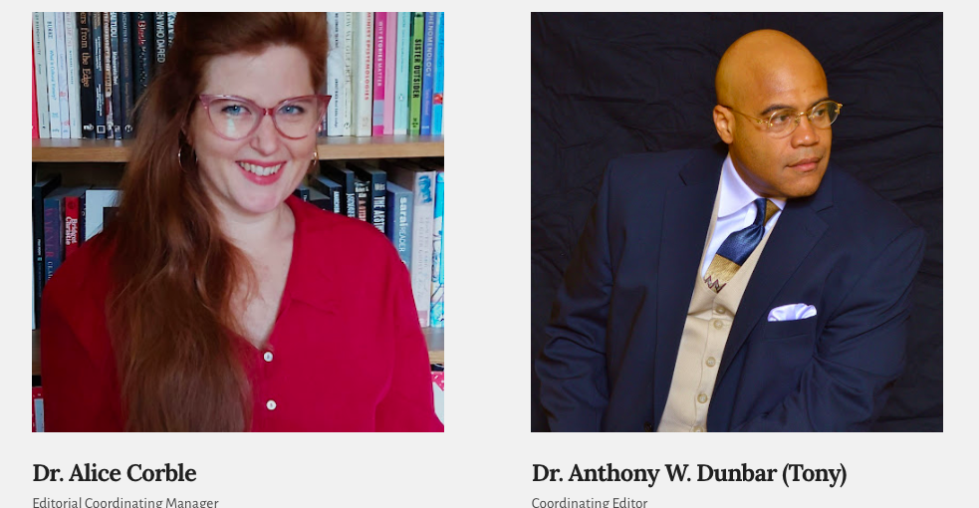
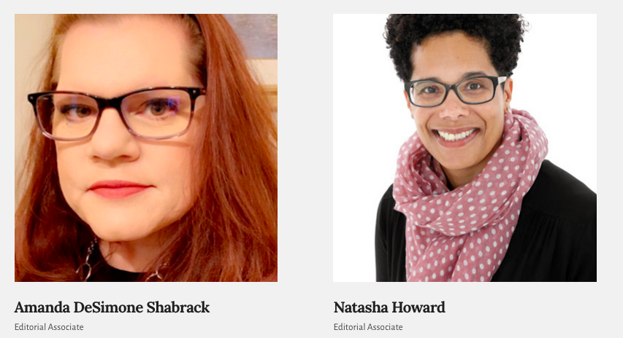
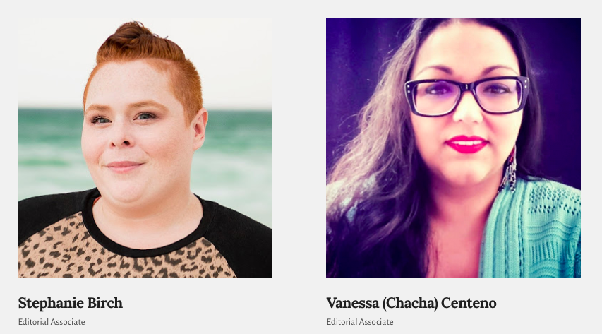
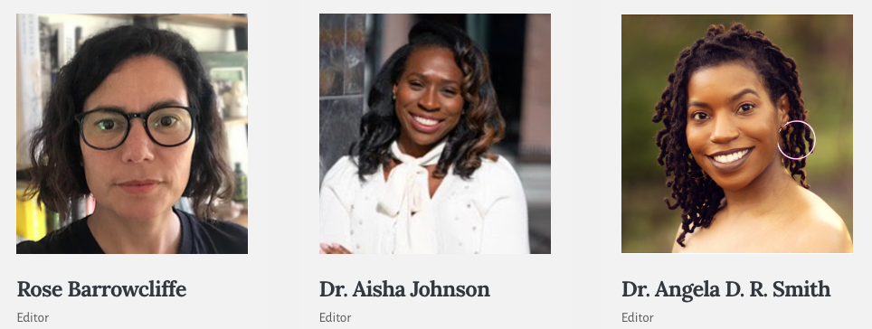
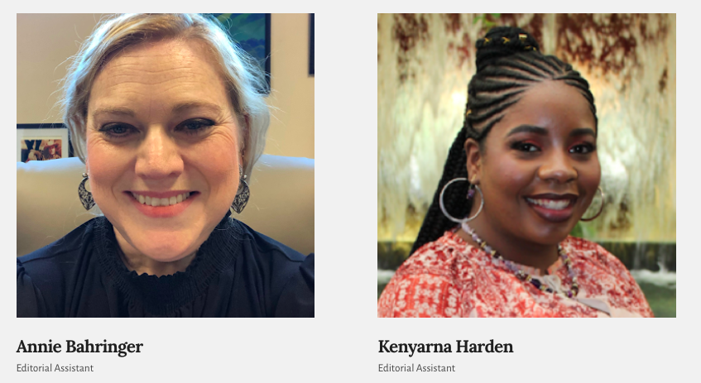
Who is The CRT COllective?
A group of scholars, librarians, archivists, and information professionals from across the globe whose mission is to provide an inclusive outlook on critical race theory and its adjacent topics while encouraging continuous dialogue and scholarship.

Slide 4
CRTc Media Strategy
OUR VISION…as an evolving international collective is to provide an inclusive outlook on critical race theory with roots in historical representation and ethical considerations to engage and encourage continuous dialogue and scholarship. We hope to build a collaborative movement of intellectual advocates and activists addressing injustice.
Vision connected to media and digital content creation.
Primary focus is on CRT from its origins in law to how it has expanded to other disciplines, most notably LIS.
Interview CRT legends/icons and raising contributors
Look for opportunities to present CRT as practice, pedagogy, and/or activism
Secondary focus is on injustice and social justice/social consciousness both within and beyond traditional professional, political, and academic discussions…such as art and general human interest
Media as Community Building
To further advance CRT in LIS requires an engaged community committed to advancing CRT within the discipline and interdisciplinarily.
Be inclusive in a content creation, each contributor has as a following, which can add to our following
Guest bloggers
Guest interviews
Hosting a syllabus or Zotero library/folder
Maintain current relevant content on our media channels along with some historically relevant content.
Building a community will also help with future Call for Papers for either Journal special Issues and/or edited books
Lead with excellence; or content and delivery of content should develop and evolve as strive for excellence. Present great work has its own law of attraction

Slide 5
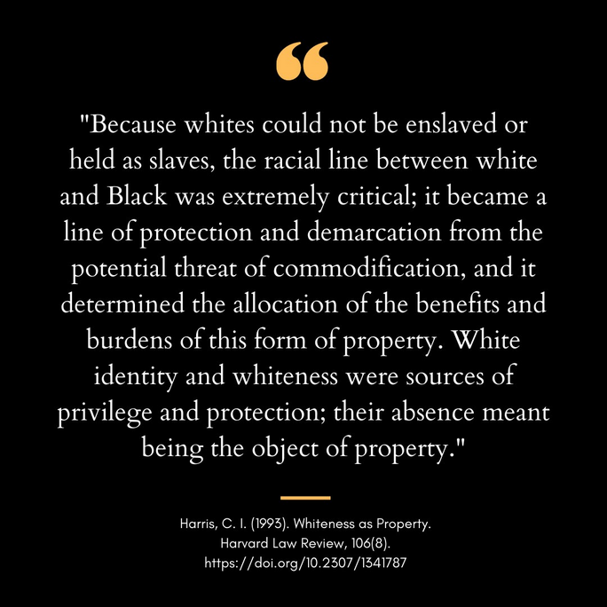
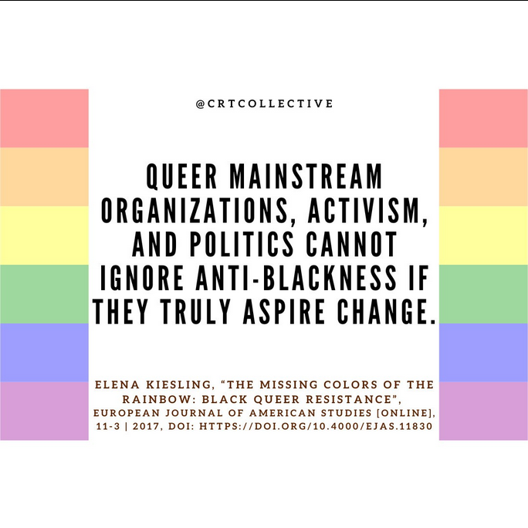
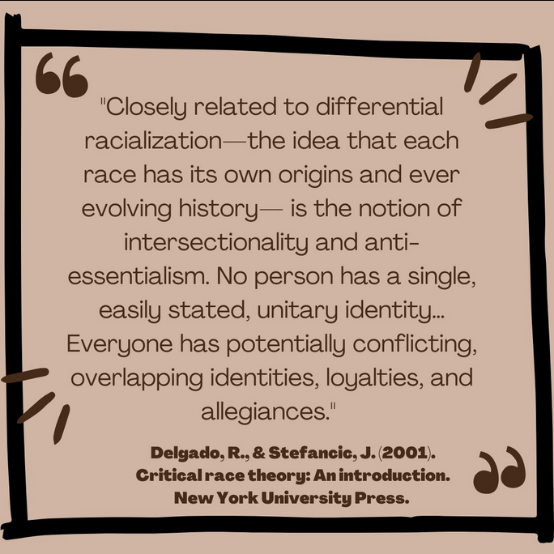


Content Creation
Created using design tool Canva
Take ideas/quotes from CRT/related scholarship to educate and generate discussion

Slide 6
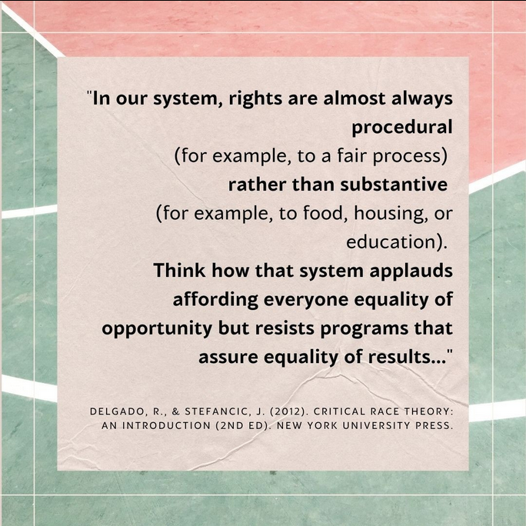

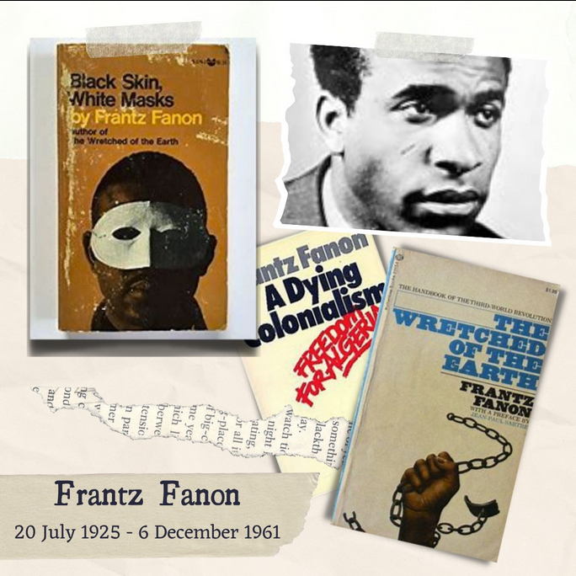
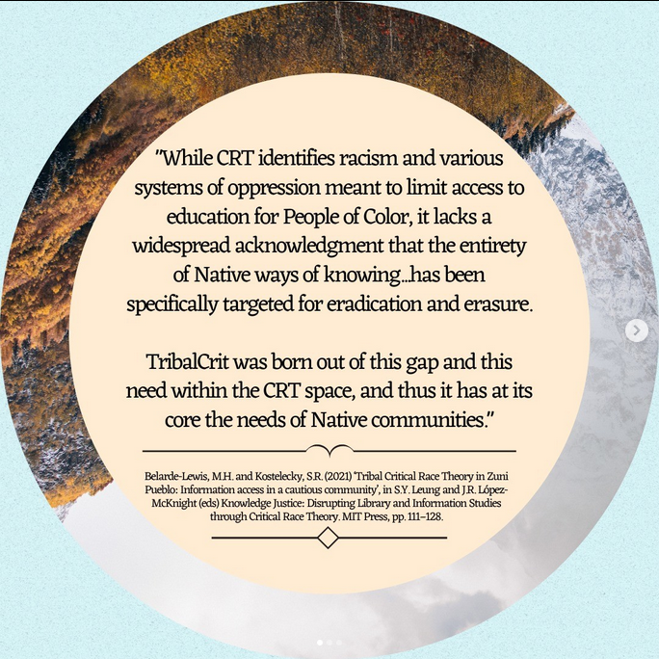

Slide 7
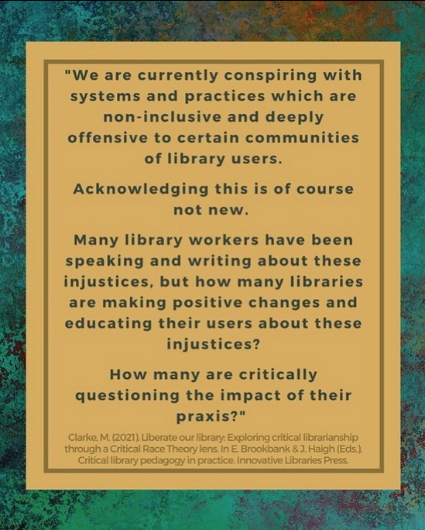
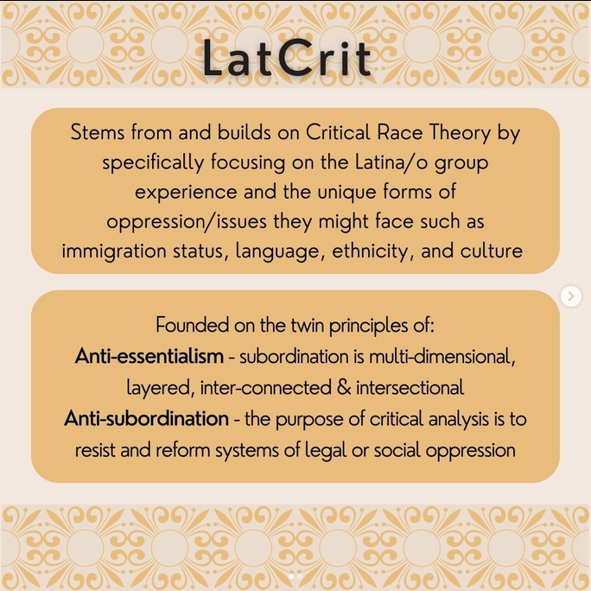


began incorporating more consistent colors/styles to make a more cohesive brand image

Slide 8

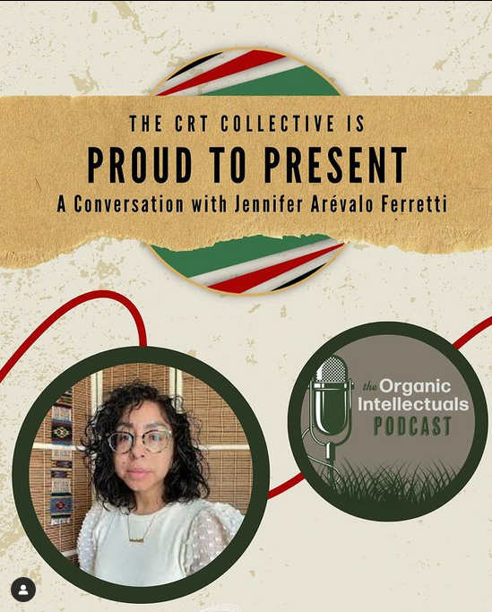
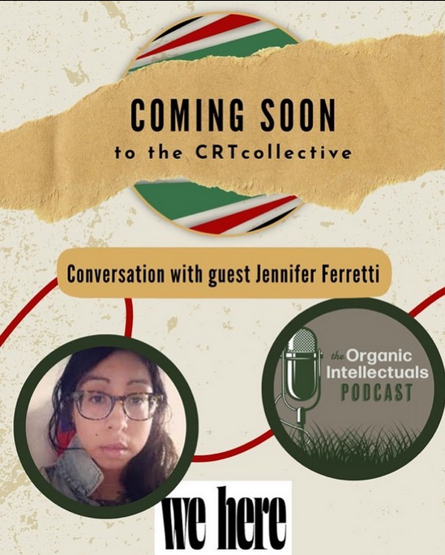
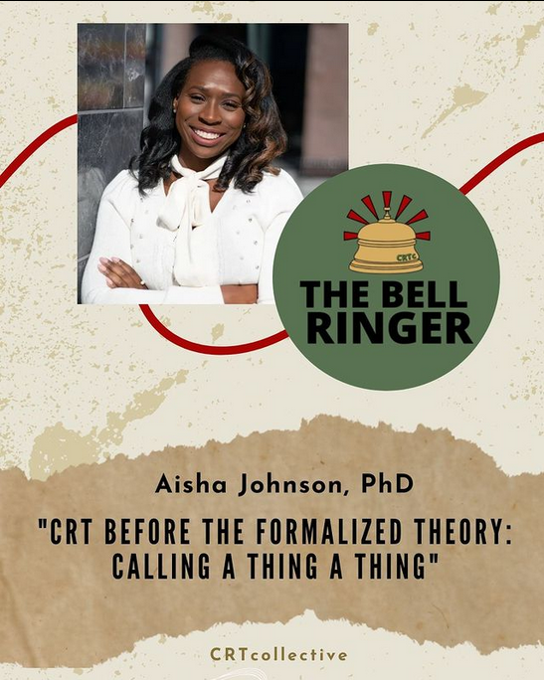
developed a reusable, branded template to promote guests of the blog “The Bell Ringer” and The Organic Intellectuals podcast

Slide 9
Plan & Execute Planned Content While remaining flexible to arising needs
Week of | TOPIC/THEME
Sept 5 | Micragression & Chester Pierce Promote Danny Solarzano and Lindsey Huber's book on Microaggression.
Sept 19 | LatCrit
Oct. 3 | Richard Delgado - honoring him on his birthday Counternarrative
Oct 17 | Supreme Court reconvene (10/3) and Reproductive Justice
Oct. 31 | Derrick Bell - honoring him on his birthday and promoting the Bell Ringer
Nov. 14 | Indigenous / Decolonization
Nov 28 | Intersectionality
Dec 12 | bell hooks and promoting the Bell Ringer

Slide 10
Reach out to Potential Blog/podcast Guests & Schedule meetings
Outreach Email Templates
Subject: CRT Collective Interview Request
Hello (name),
My name is (name) from CRT Collective. We are a group of scholars and information professionals from across the globe whose mission is to provide an inclusive outlook on critical race theory and its adjacent topics while encouraging continuous dialogue and scholarship.
I became familiar with your work through (example) and would love to chat more about your ideas surrounding (example). The CRT Collective is currently developing a podcast and blog where we hope to showcase ideas such as yours.
Would there be a time in the near future when we could discuss the possibility of an interview?
You can find out more about us at crtcollective.org or through our Twitter and Instagram.
Let me know if you have any questions!
Thank you,
(name)

Slide 11
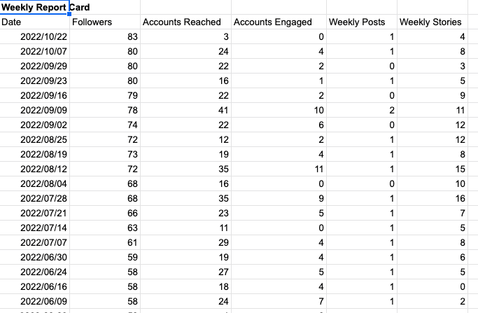
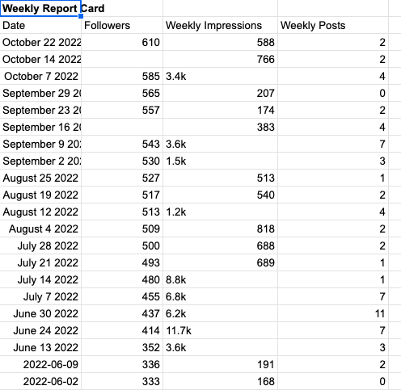
Track social media Engagement
Instagram
Twitter

